Slide 1
Recommendation Systems Mini-Project
By - Aakash Khot (IMT2020512), Agastya Thoppur (IMT2020528) and Anwit Damale (IMT2020532)

Slide 2
About the dataset
The MovieLens dataset consists of approximately 1 million ratings of 4000 movies by over 6000 users on IMDB.
The dataset is divided into three files, users.dat, movies.dat and ratings.dat.
users.dat consists of additional information about each user (Gender, Age, Occupation, Zipcode), and movies.dat consists of additional information about each movie (Title, Genre).

Slide 3
Exploratory Data Analysis
Before diving into building a good recommendation model, it’s important to first understand the dataset and its intricacies.
EDA gives us a better idea on patterns and relationships in the dataset, and can also provide explainability on why recommender models work the way they do.

Slide 4
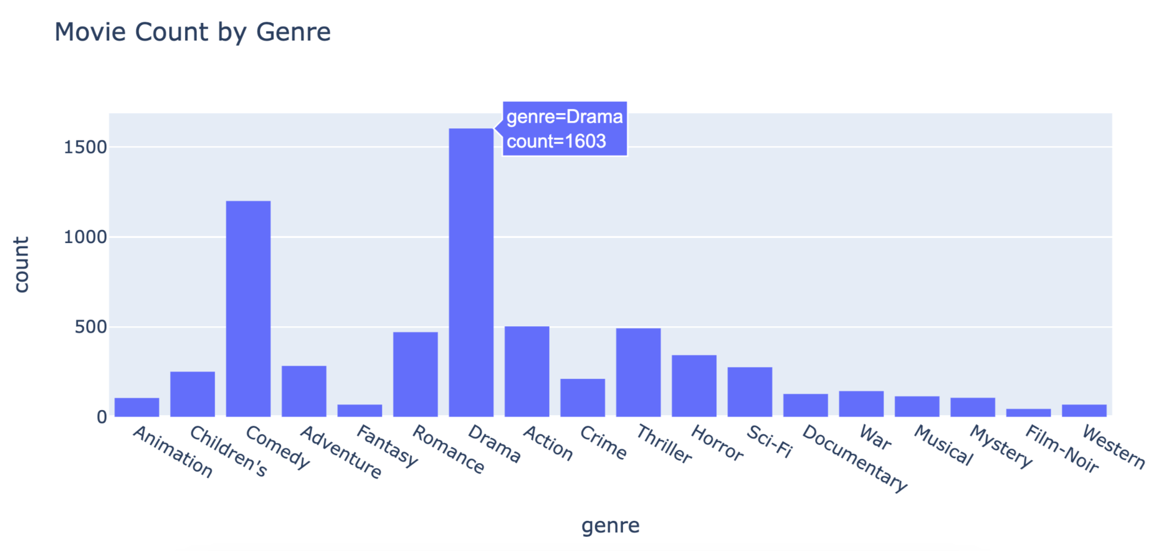

Slide 5
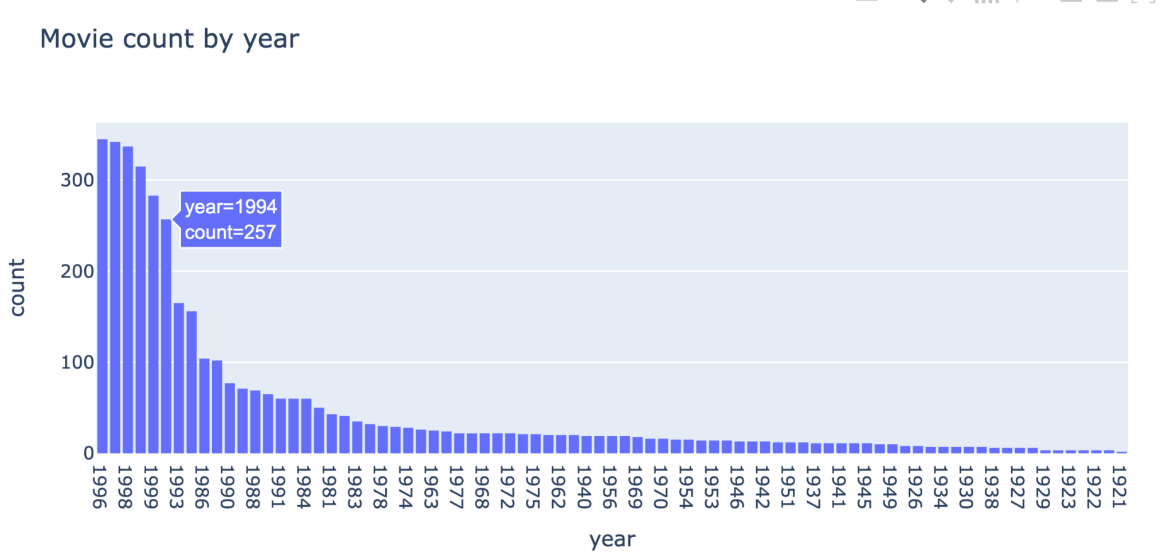

Slide 6
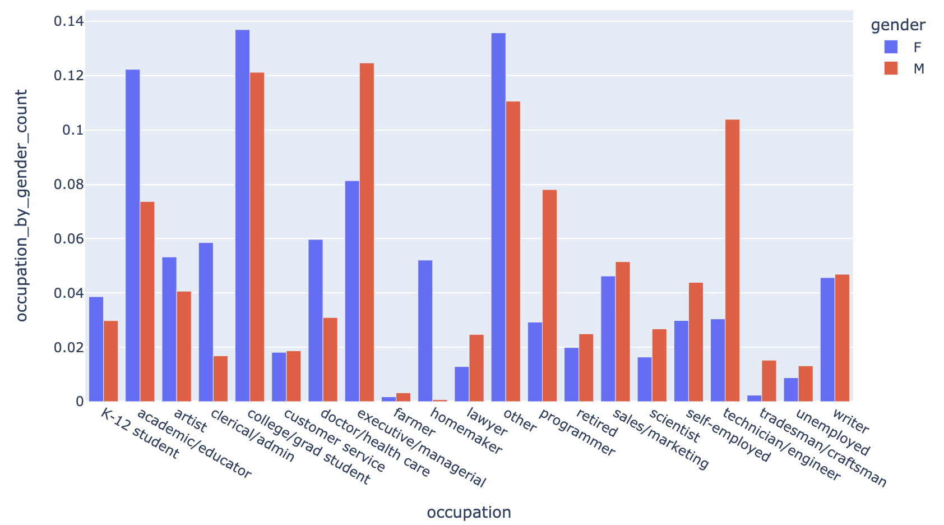

Slide 7
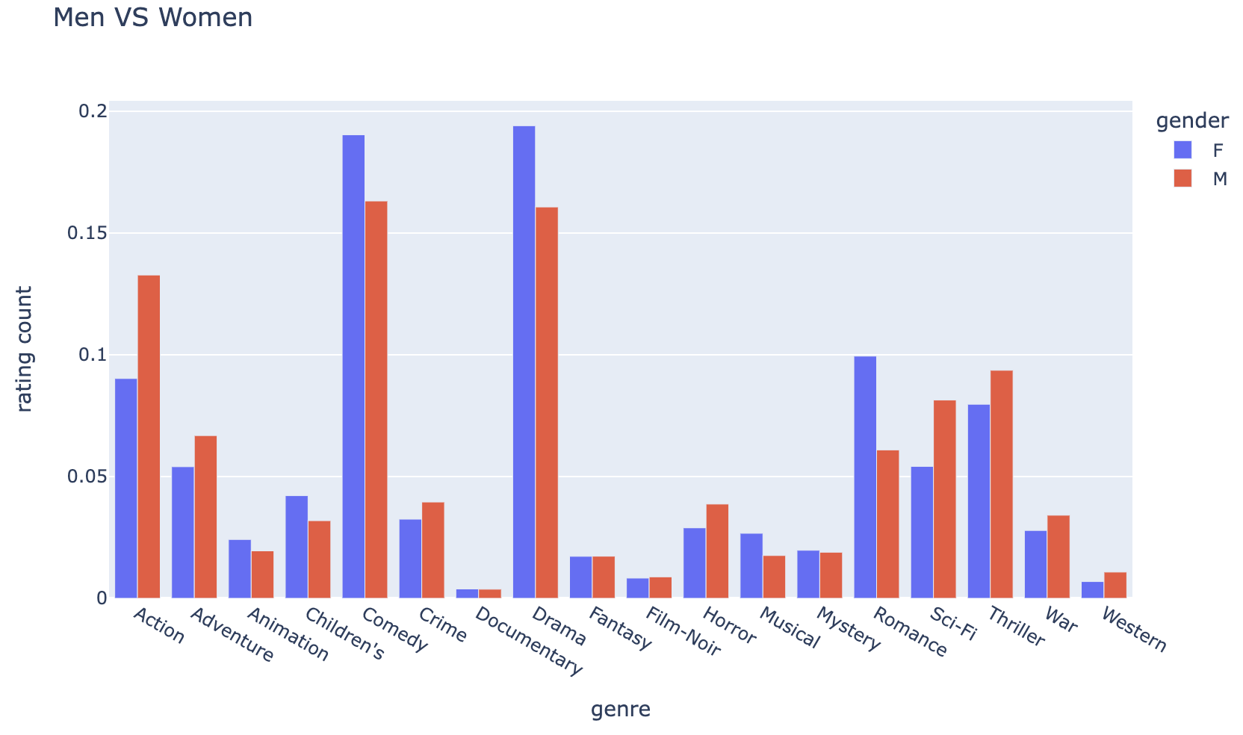

Slide 8
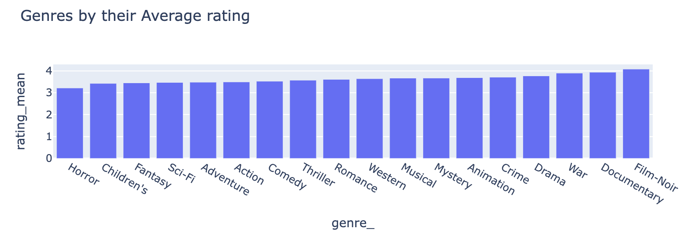
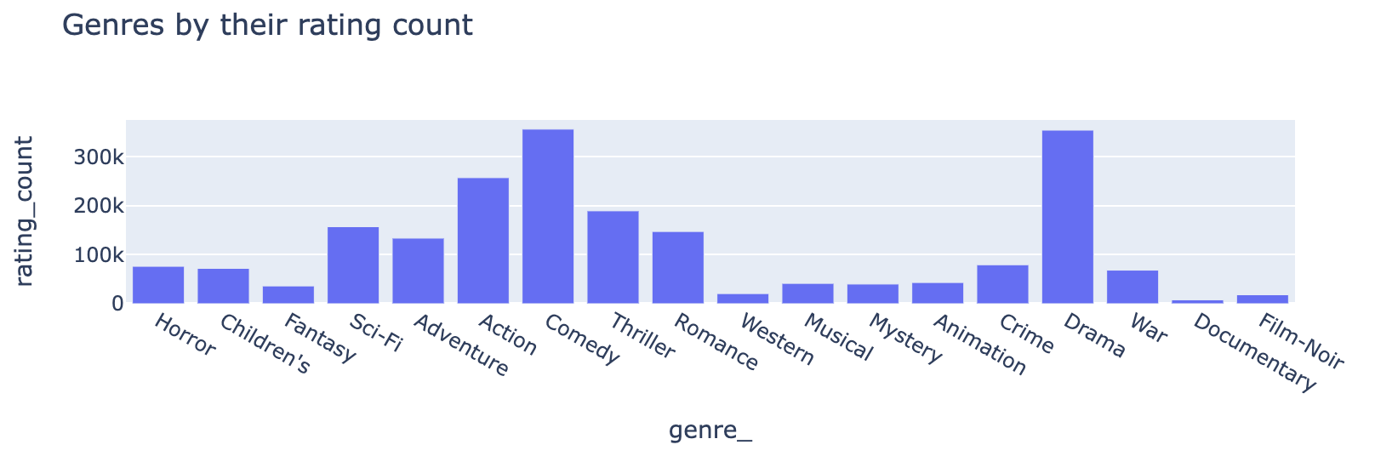

Slide 9
Pre-processing for Collaborative Filtering
As mentioned before, the dataset consists of three files.
User-based Collaborative Filtering primarily relies on the idea that a new user having similar ratings to a bunch of existing users is likely to agree on their ratings of items unseen/unused by him.
Since this type of recommendation system only looks at a new user’s similar neighbors, we simplified the dataset into a table with UserID as the index and Movie Titles as the columns. Each entry in the matrix is a user’s rating of a particular movie.

Slide 10
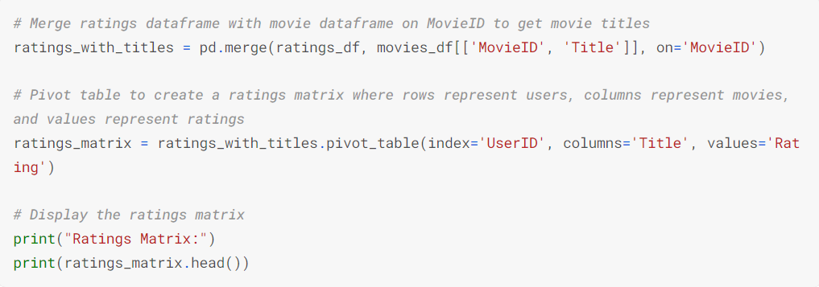
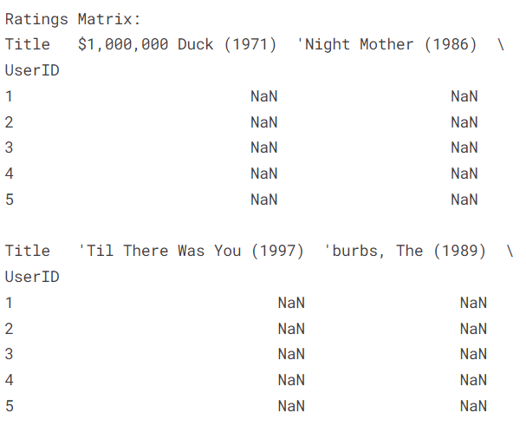
Pre-processing for Collaborative Filtering

Slide 11
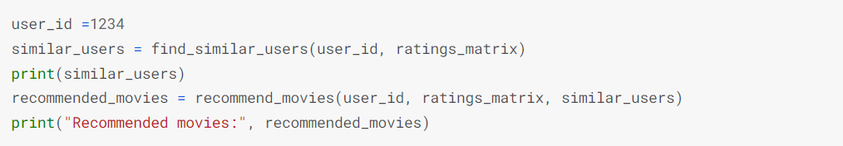
Collaborative Filtering for an existing user
The find_similar_users function simply uses the cosine similarity measure to get the k (by default 5) users that have ratings most similar to the existing user.
recommend_movies iterates over similar users, computes a weighted rating for each unrated movie, normalizes the ratings, and returns the top n recommended movies based on their scores.

Slide 12
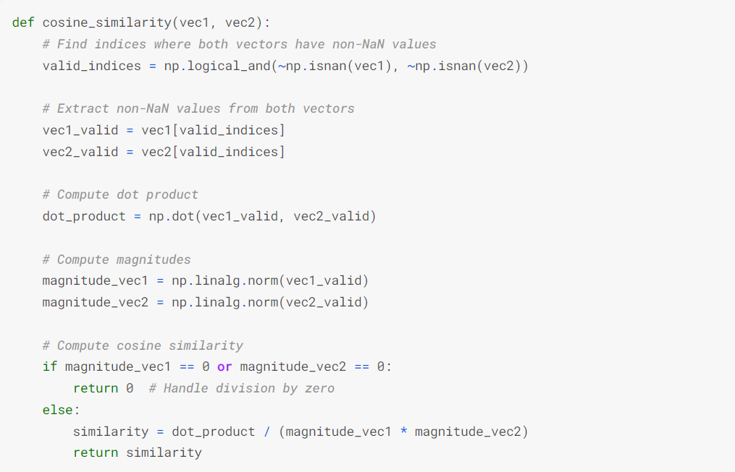
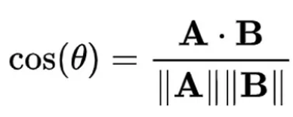
Cosine Similarity
This is the function we used to calculate cosine similarity. We had also tried out Jaccard similarity and Pearson’s correlation, but this gave us the most sensible results.

Slide 13
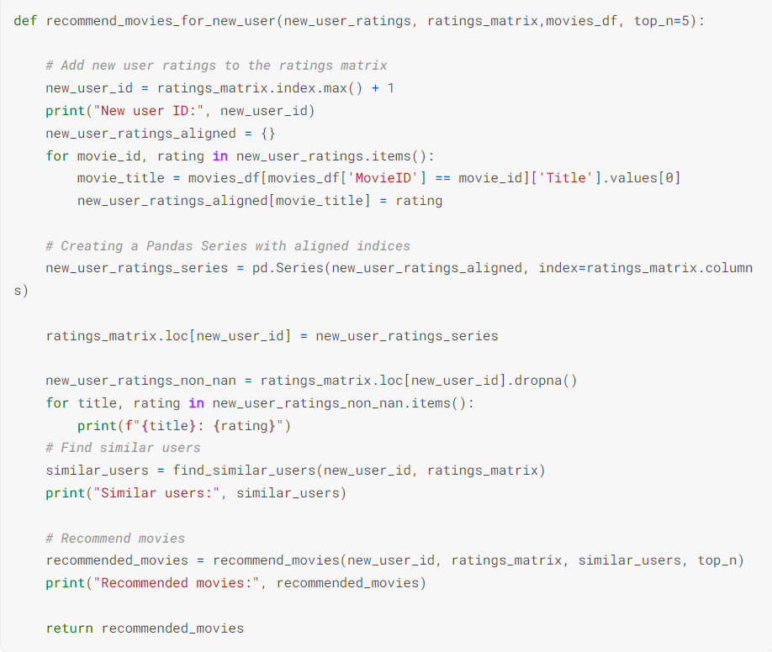
Collaborative Filtering for a new user
recommend_movies_for_new_user adds new ratings to the ratings matrix and then carries out the same function -ality as recommend_movies.
It allows a new user to get a visible side-by-side comparison of his own ratings and recommendations.

Slide 14
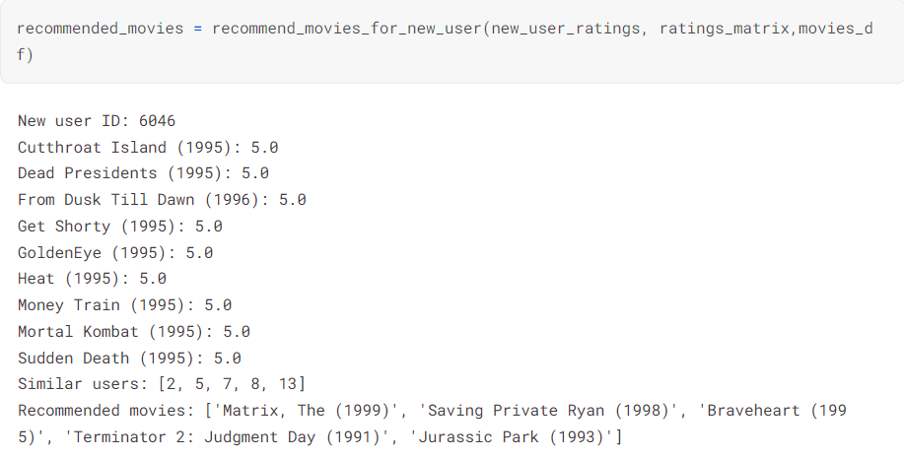

Slide 15
Pre-processing for SVD + K-Means
Rather than using the same ratings matrix as we did for collaborative filtering, we adopted a different approach.
For recommendations using SVD + K-Means, we simplified the dataset into a table with UserID as the index and “individual genre” as the columns. There are 18 individual genres in the dataset.
Each entry in this matrix is the user’s average rating for movies of that particular genre.

Slide 16
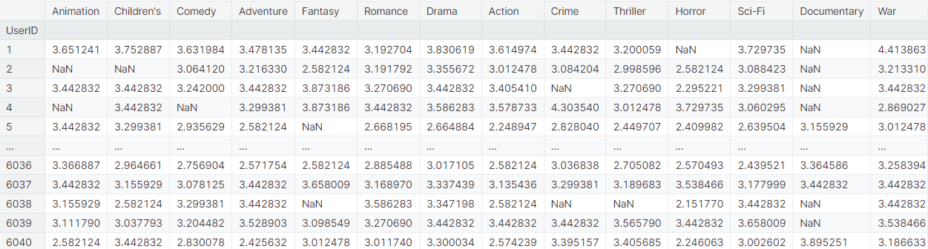
Pre-processing for SVD + K-Means
Below is how the user-genre ratings matrix looks. A null value in this matrix means that a user has not watched a movie of that particular genre.

Slide 17
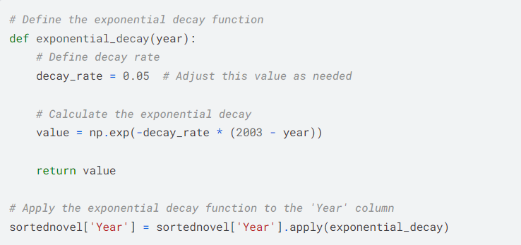
Novelty
Since a user’s tastes can change over time, a system can provide better recommendations to a user by giving additional weightage to more recent ratings.
This is implemented using the exponential decay function. The ratings_df dataset is recalculated using this function.

Slide 18
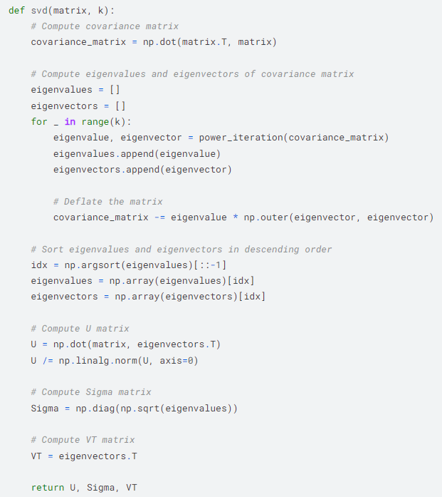
SVD
SVD decomposes the matrix into three generic linear approximations that denote its underlying structure.
This is the function we used to impleme -nt SVD from scratch.

Slide 19
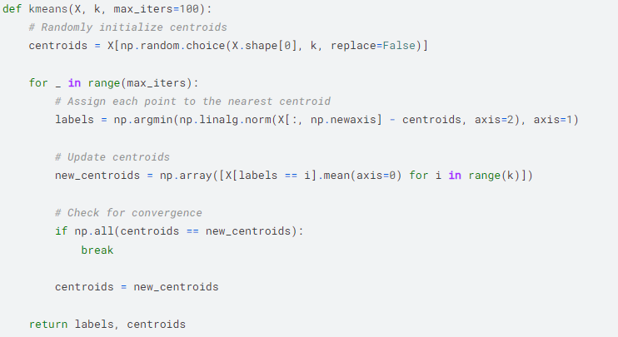
KMeans
This is the function used to implement K-Means from scratch.
The elbow method was used to find the optimal number of cluster centroids.

Slide 20
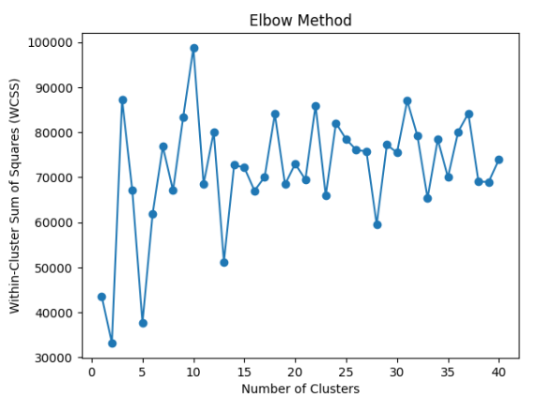
Elbow Plot

Slide 21
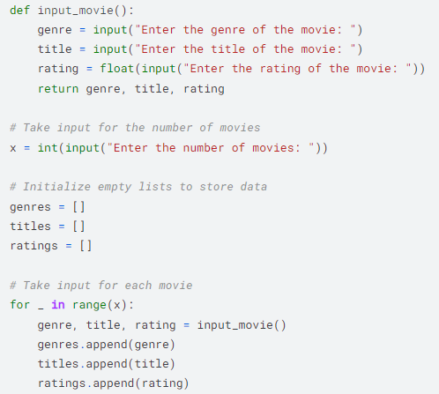
SVD + K-Means recommendations for new user
Once the number of cluster centroids have been decided, we input a new user’s movie ratings.
This is converted to a vector with each entry consisting of the user’s average rating for a particular genre.

Slide 22
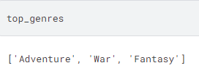
SVD + K-Means recommendations for new user
The user is then assigned to a cluster, and the top genres of that cluster are fetched. This is done by getting the genres of the top 3 average ratings of that cluster centroid.
The top five movies of the specified genres are recommended to the user.

Slide 23
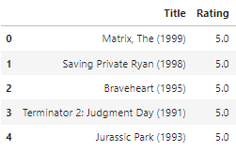
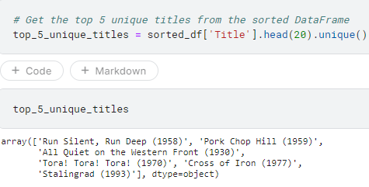
SVD + K-Means recommendations for new user
User input
Recommendations

Slide 24
Which method is better?
Since collaborative filtering only takes into account neighboring user ratings and not content-based features such as genre and timestamp, SVD + K-Means gives us better recommendations than the former.
The additional novelty of giving lower importance to movies that have been rated a long time ago improves the traditional SVD + K-Means method, giving it a significant edge over Neighborhood-based collaborative filtering.

Slide 25
Thanks

Slide 26








International Institute of Information Technology Bangalore
26/C, Electronics City, Hosur Road,
Bengaluru – 560 100, Karnataka, India
www.iiitb.ac.in
https://www.facebook.com/IIITBofficial/
https://twitter.com/IIITB_official
https://www.linkedin.com/school/iiit-bangalore/
https://www.youtube.com/user/iiitbmedia
https://www.instagram.com/iiitb_official/

